Slide 1
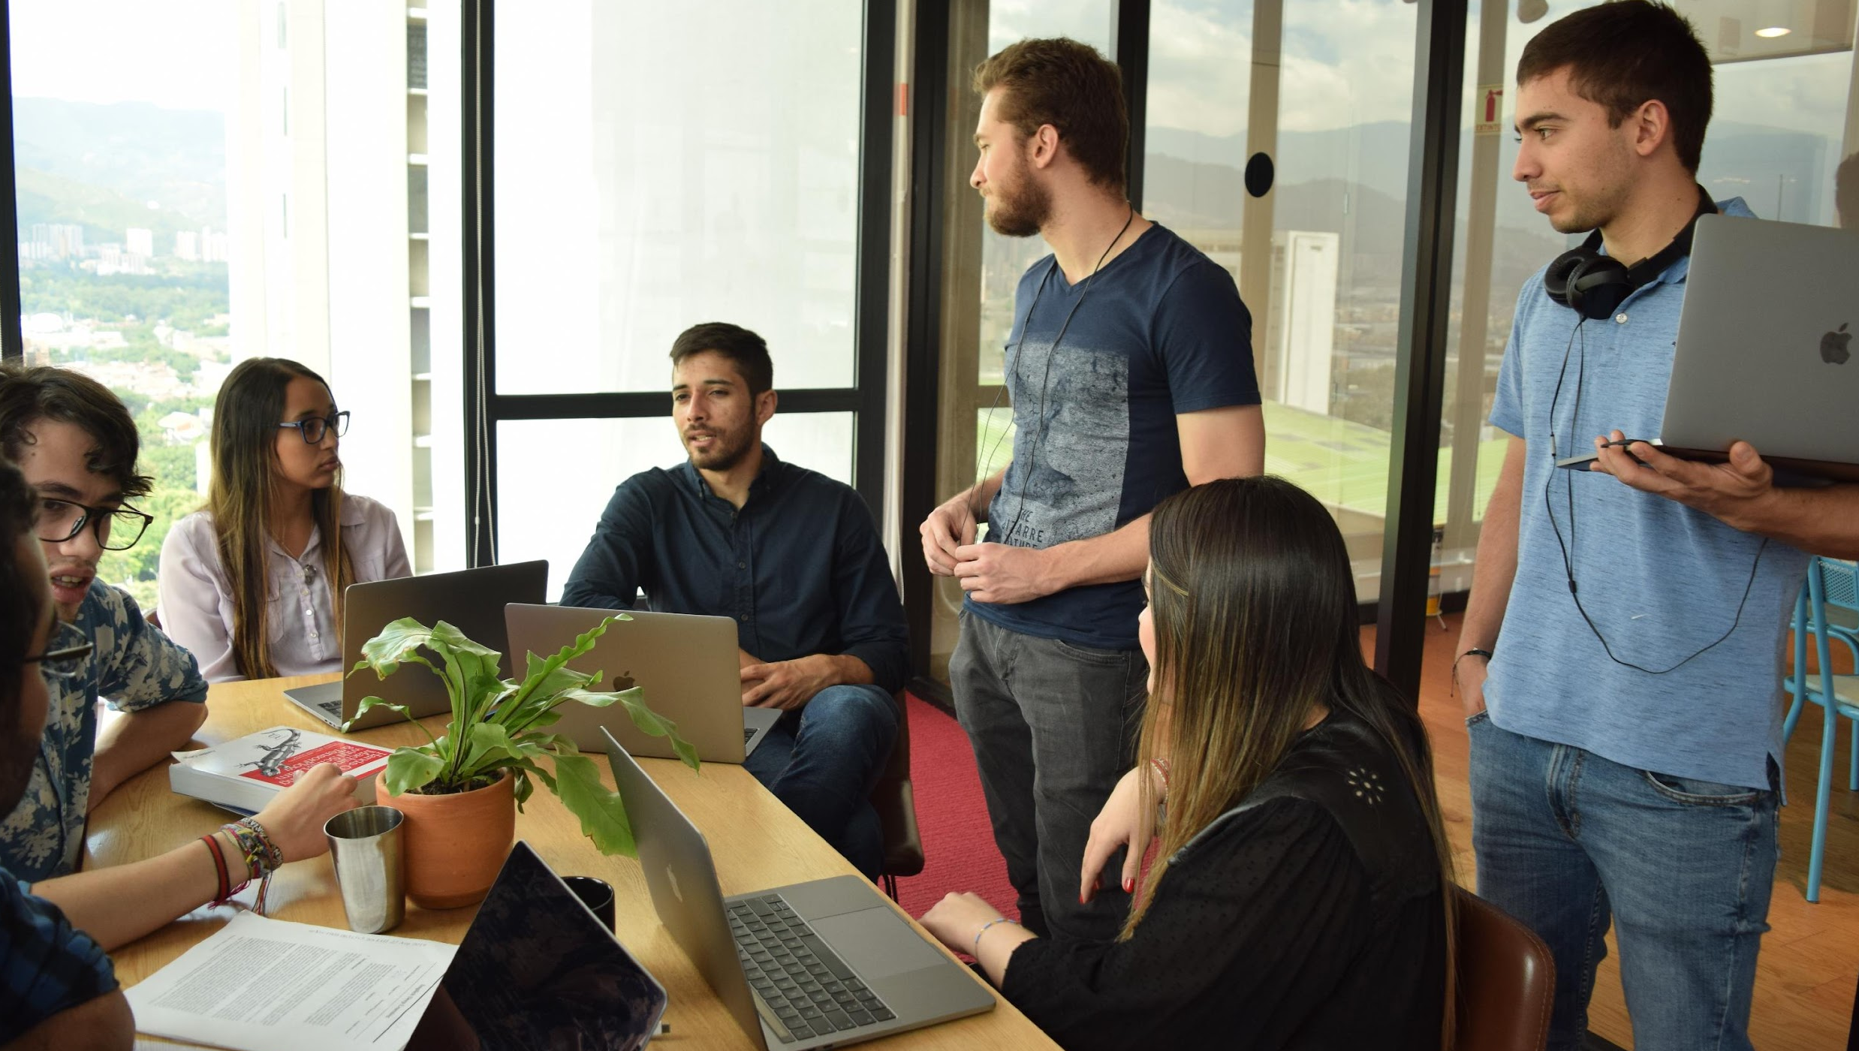



Personal Project Image Similarity Carlo di Francescantonio Torrado

Slide 2
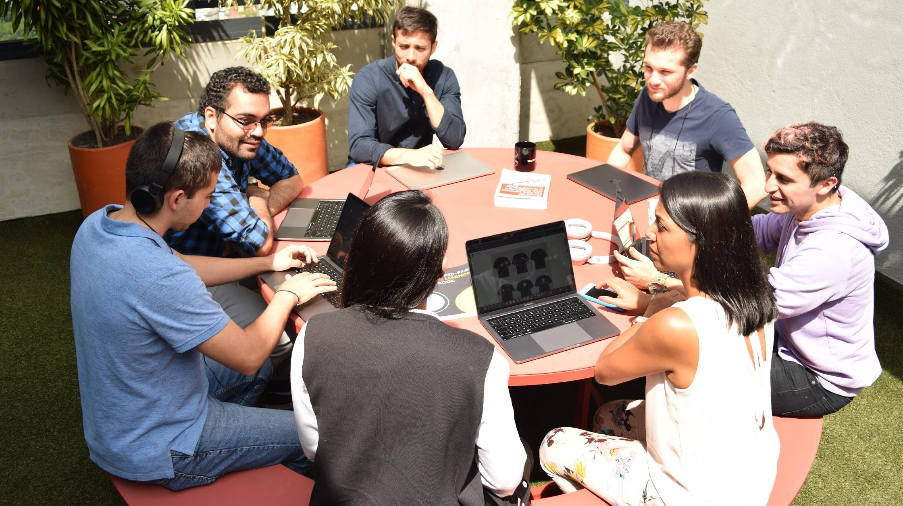

Scope of the Project

Slide 3


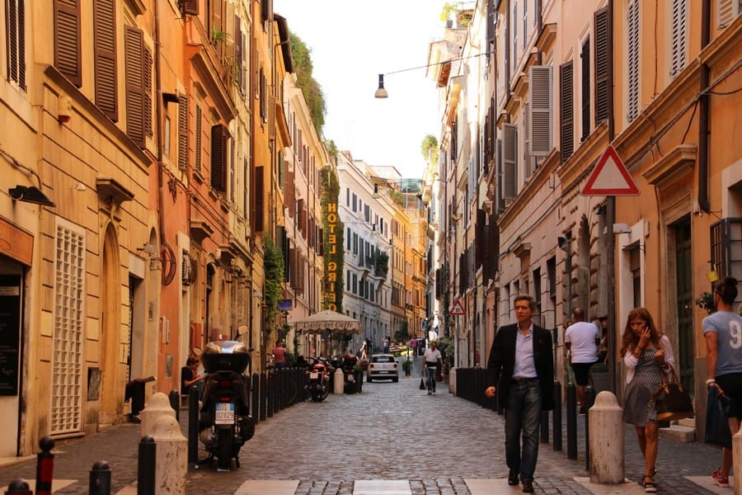
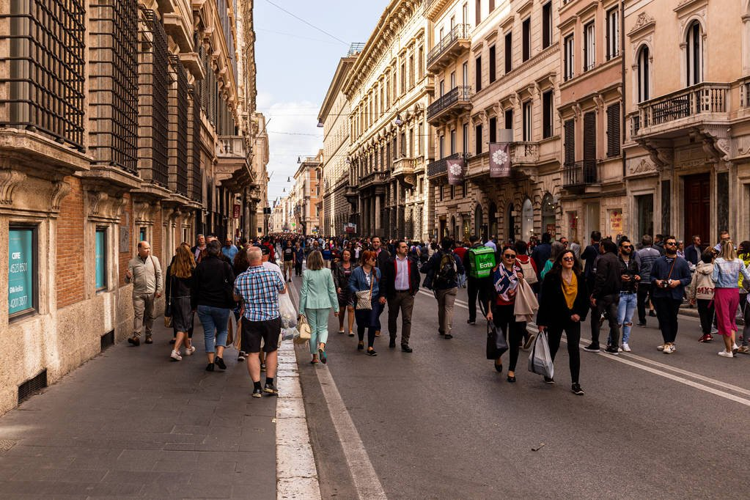
Main Goal
Given an image return a similar image in terms of semantic content using novel Deep Learning techniques.
Input
Output

Slide 4
What I want to learn or practice?
During this project I want to develop my skills on:
Computer Vision (SOTA)
Cloud Services
Model Deployment
Database management systems

Slide 5

Deep Learning

Slide 6
First Approach: Image Classification
First, I thought that I could train a model that given an image it returns a list of the objects in it without intermediate steps:
Person
Motorbike
Car
Building

Slide 7
First Approach: The Problem
There are a lot of great deep learning models that do image classification, but most of them are optimized for single target. For example, lets consider the Inception Model:
Inception (V3 - 2015)
{
'Altar',
'Ashcan',
'Barrow',
'Bell Cote',
'Bookshop',
'Cab',
'Church',
'Gondola',
'Moving Van',
'Police Van',
'Street Sign',
'Streetcar',
'Triumphal Arch',
'Trolleybus',
'Vault’
}
This result was not bad at all, but Inception’s final layer is a SoftMax as its main objective is to classify the image into a single object. I needed to set a threshold either for the output vector (either removing or not the final layer) or a setting fix number of objects in each image.
Notes:
Inception model is trained with the ImageNet dataset in mind. It returns the probability of each of the 1000 classes with a softmax

Slide 8
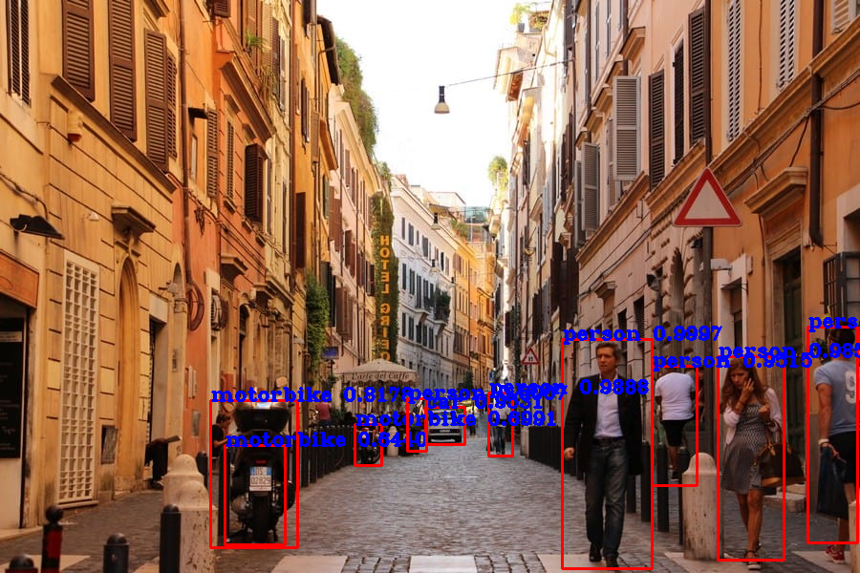
Second Approach: Object Detection
When comparing the output to what I wanted, I noticed that the way a human identifies objects in an image is much similar to the way object detection works. Let's consider the YOLO model for this:
YOLO (V3 - 2018)
{
'car’,
'motorbike’,
'person’
}
Notes:
This is much more similar to what a human does! But its missing lot of objects.

Slide 9
Philosophical Question!
Should we focus on creating models that mimic the way humans think?

Slide 10
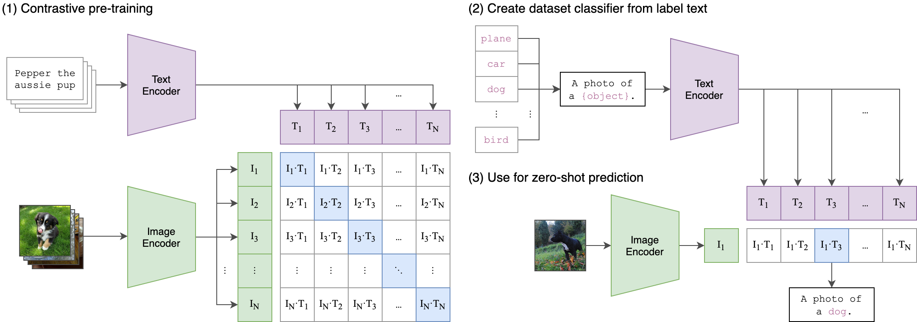
Bonus: OpenAI Clip
A brand-new contender (2021) that looked great! Link
However, speed was a limitation for this model as it is particularly slow as we use more and more object classes. However, it is a cool project to have in mind!
Notes:
This is much more similar to what a human does! But its missing lot of objects.

Slide 11

The Project

Slide 12
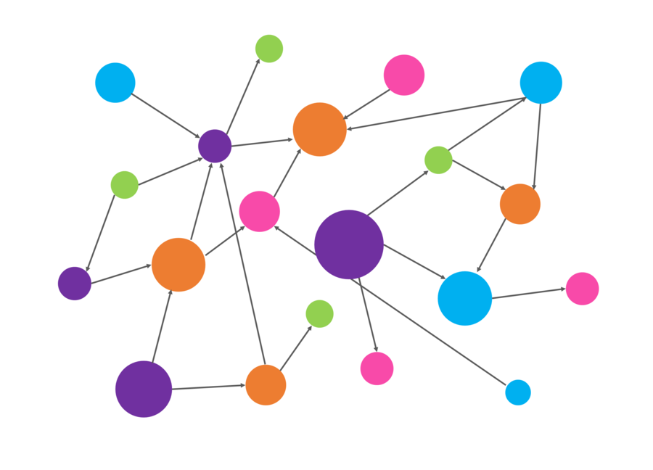

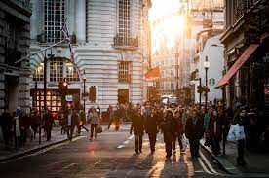
The Final Project
Compare two different concepts to find similar images:
Concept # 1:
Input
{
'car’,
'motorbike’,
'person’
}
YOLOv3
Neo4j is a graph database management system developed by Neo4j, Inc. Described by its developers as an ACID-compliant transactional database with native graph storage and processing.
Notes:
This is much more similar to what a human does! But its missing lot of objects.

Slide 13
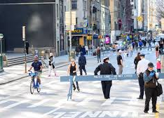
The Final Project
Compare two different concepts to find similar images:
Concept # 2:
Input
array(
[1.37590517e-01, 7.44612979e-01, 9.53273176e-01, 3.92851813e-01,
2.30688584e-01, 9.84468996e-01, .............., 9.97833358e-01]
)
array(
[1.32590517e-01, 7.44612979e-01, 9.53273176e-01, 7.92851813e-01,
2.30688584e-01, 9.84468996e-01, ..............,
9.97833358e-01]
)
InceptionV3
Linear Algebra
array(
[1.32530517e-01, 7.48612979e-01, 3.53273176e-01, 6.92851813e-01,
2.30748584e-01, 9.84468396e-01, .............., 5.97833358e-01]
)
Similar Image
array(
[2.32590517e-01, 4.45612979e-01, 9.53273176e-01, 7.92851813e-01,
2.30688584e-01, 9.84468996e-01, .............., 9.97833358e-01]
)
Compare the output vector of the Inception model to the ones of lots of images that are saved in our database and return the closest one.
Notes:
This is les human, but more “objects” are available.

Slide 14

The Dataset

Slide 15


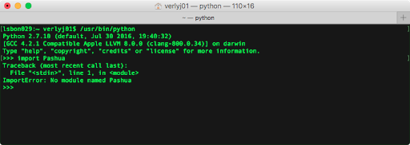
Getting the Images
I needed to get a good dataset of images that contain objects in the classes I have worked with. I could have used the COCO dataset (Common Objects in Context), but I thought it would be more fun to create my own dataset with 80 different “classes”.
For this, a Python script downloaded ~1000 images, each related to at least one of the 80 classes the YOLO model uses. The images were stored in an S3 Bucket.

Slide 16
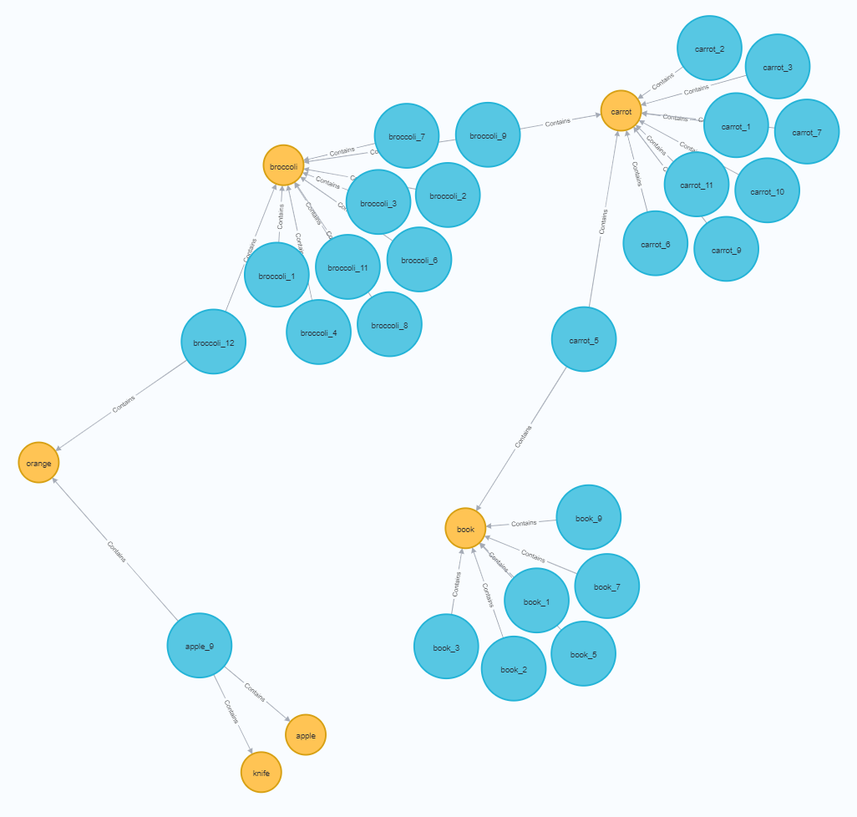
“Training” the App
Next step was to have for each image both a vector containing the information from the Inception model and a list of objects obtained from the YOLO model.
This means that for “Concept #1” we are now able to create a graph in Neo4j!
Relationships can be established in a graph and similarities can be calculated using Neo4j packages. For this PoC we used a Jaccard similarity score which Neo4j calculates with a query it received in a Python script

Slide 17
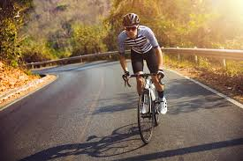
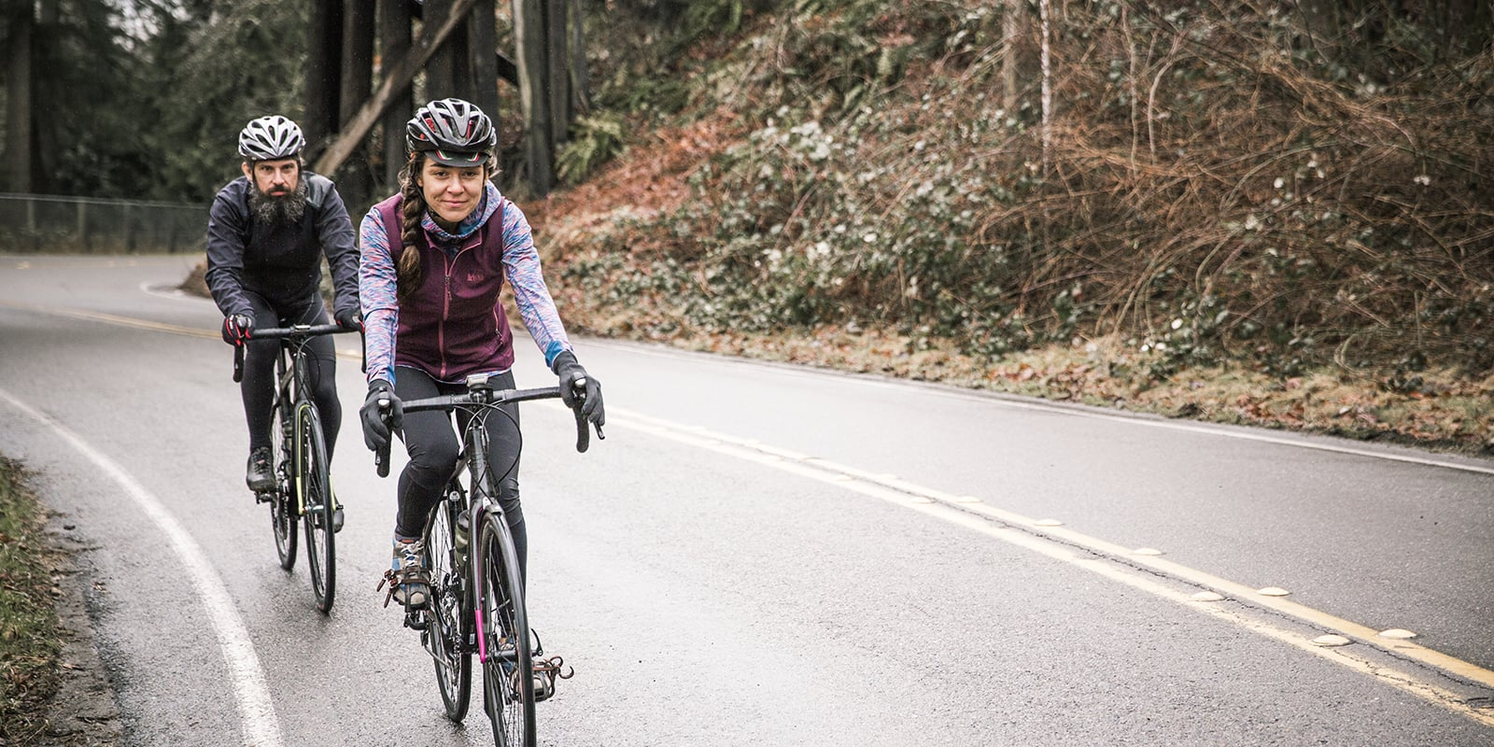
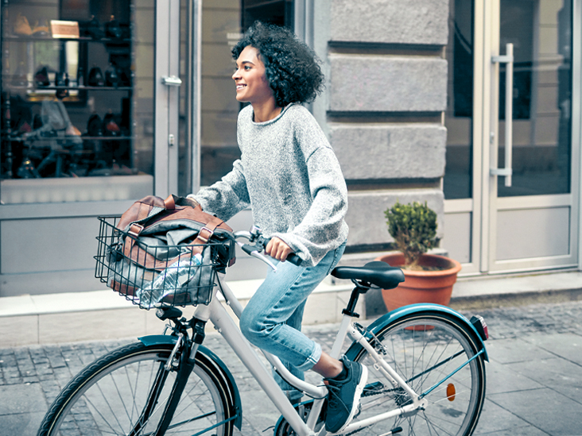
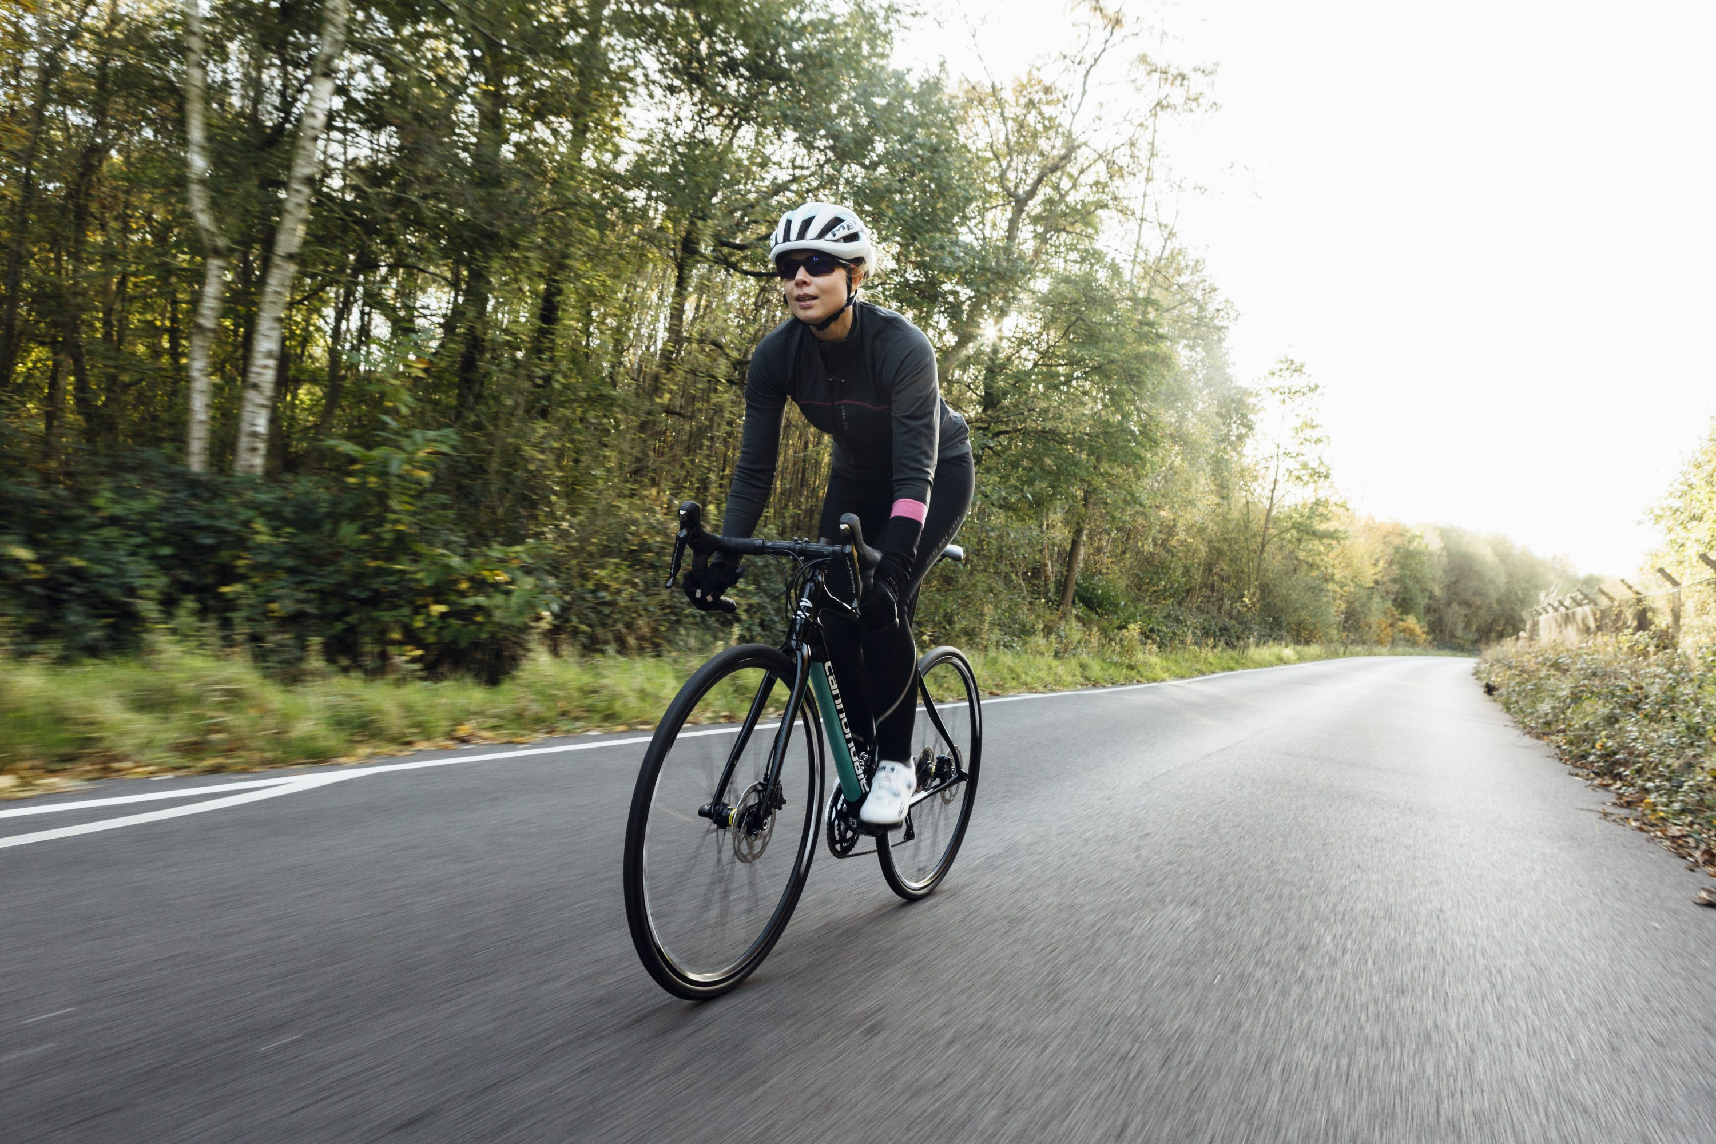

Model Output
Both models work as expected and show similar results!
Concept # 1:
Concept # 2:
Input
Output
Input
Output
Jaccard Score: 0.75
Dissimilarity Score: 0.32
Jaccard Score: 0.67
Dissimilarity Score: 0.42
Jaccard Score: 0.67
Dissimilarity Score: 0.45

Slide 18
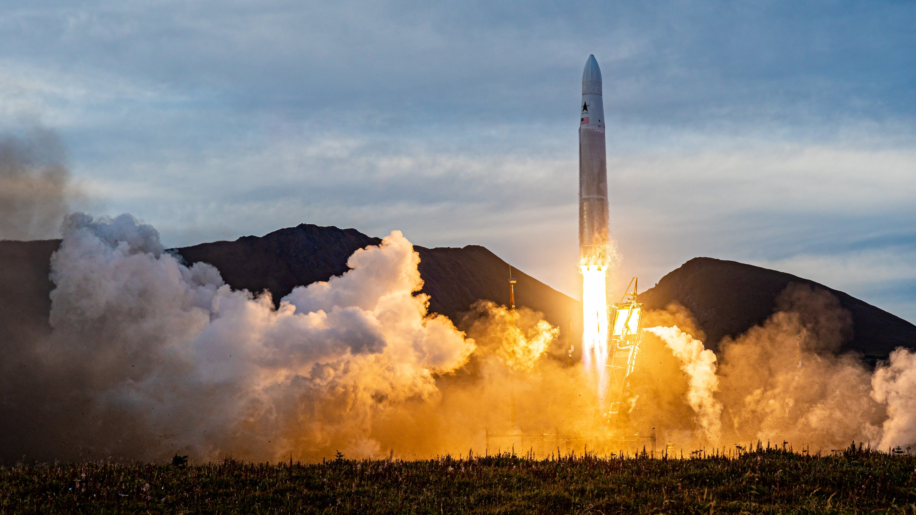
Deployment

Slide 19

Deployment
For a small deployment PoC (and to practice my AWS skills) I dockerized the app and used Amazon ECR and hosted it in AWS Fargate. For the UI, the default Swagger UI was used (WIP?).
Sadly, by this time I was already working with my client and no further improvements were done. I had to shut down the live app as it was consuming my AWS wallet, but it is all stored in a GitHub repo, and was lot of fun!

Slide 20
Thanks!

